Slide 1

User Experience and User Interface Design
3 - Android UI Design: Introduction
Dr. Seyed Reza Shahamiri More Info

Slide 2
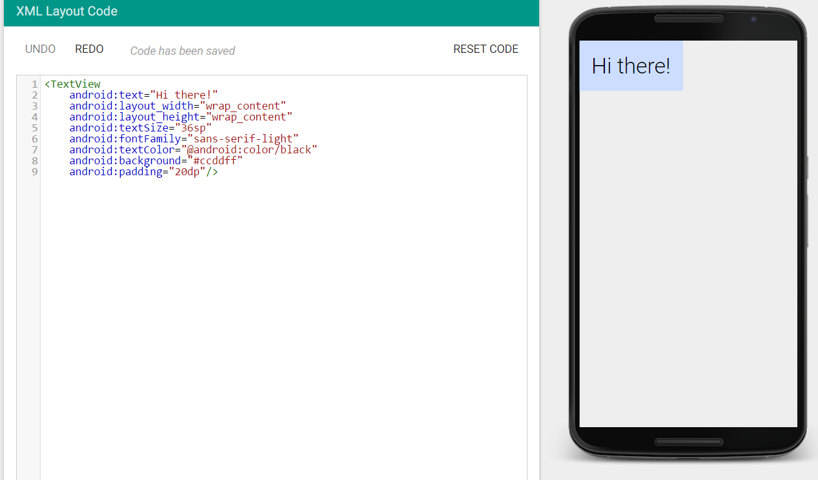

XML Visualizer
2
Android uses XML to define the UI of the app, meaning that the layout of the UI, UI controls and their locations, etc. are defined via XML files.
You can visualize Android XML code online until you install Android Studio IDE by referring to XML Visualizer:

Slide 3
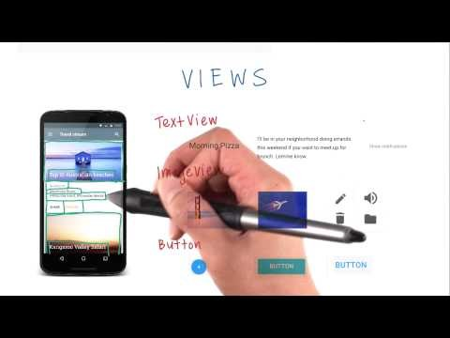
Views
3
A View is a rectangular area on the screen.

Slide 4
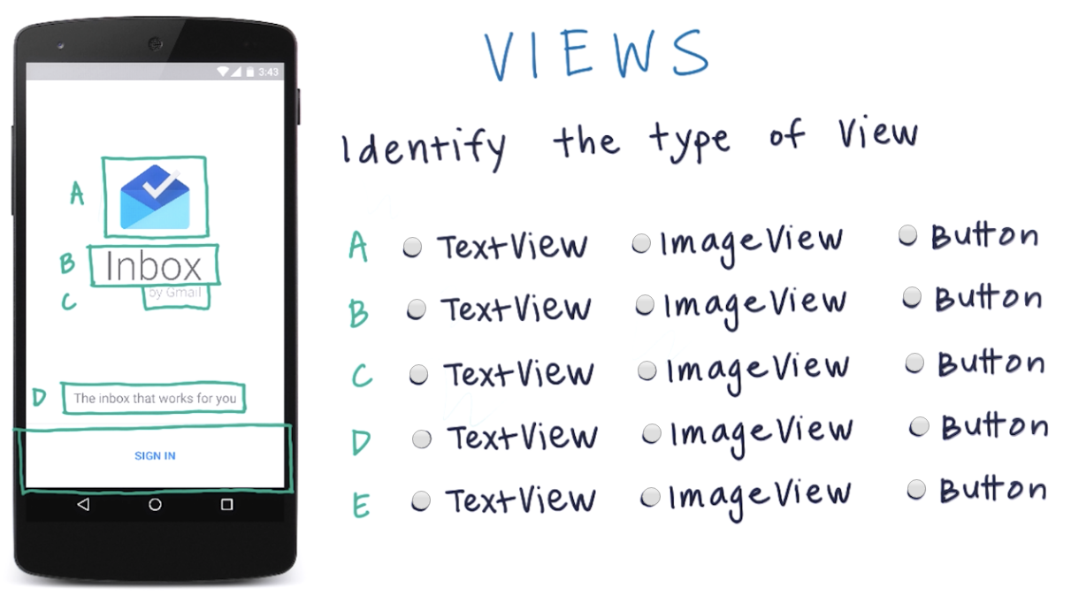
Views
4

Slide 5
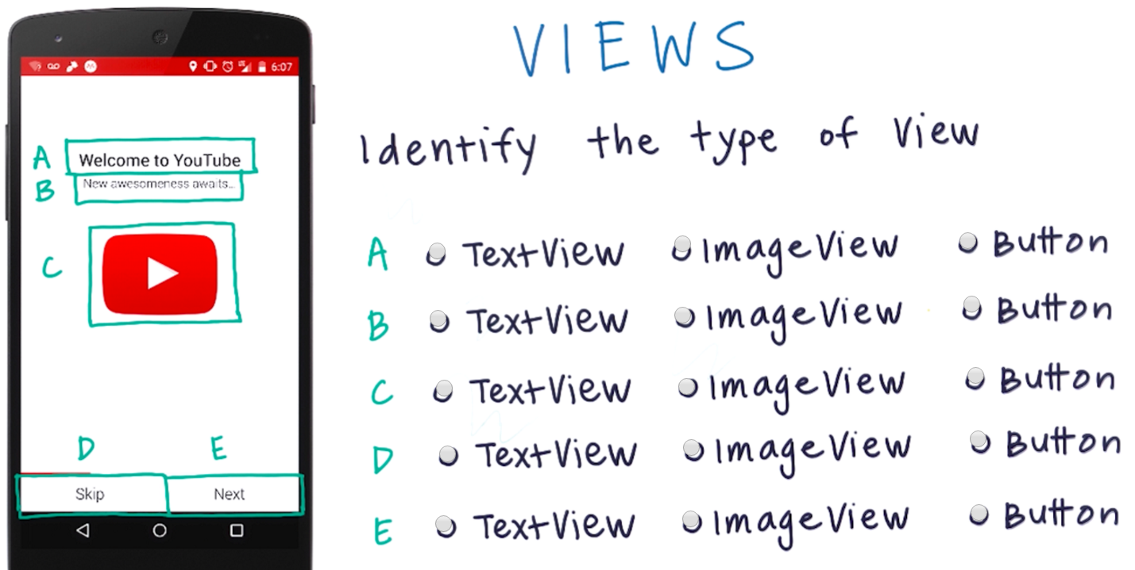
Views
5

Slide 6
Views TextView
6
A TextView is generally used to display one or more lines of text.
A TextView on the screen is drawn by a Java object inside the Android device.
In fact, the Java object is the real TextView. But when talking about what the user sees, it’s convenient to refer to the rectangular area on the screen as the “TextView”.

Slide 7
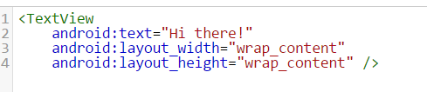
Views TextView
7
The basic syntax is:
Note that Android is case sensitive.
Opening tag
Closing tag
TextView attributes
Value for each attribute

Slide 8
Views TextView Attributes
8
Each UI control (like TextView) has a set of predefined attributes (or properties).
Attributes are characteristics that determine the behaviour or the appearance of the view on the Android device.
For example, they can be used to specify how it should be shown, its size and location, what it should show, etc.
The value of these attributes define these characteristics.
Google provided complete documentation for each attribute of each type of view/control in https://developer.android.com/index.html.

Slide 9
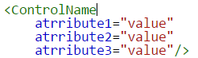
Views TextView Attributes
9
For example android:text is the attribute that displays the text to be shown by the TextView.
The attributes must be defined between the control tags and before the closing tag:
All attribute values must be between quotation marks “value”.
Some android controls have default values. In this case you only mention them if you want to change them.

Slide 10
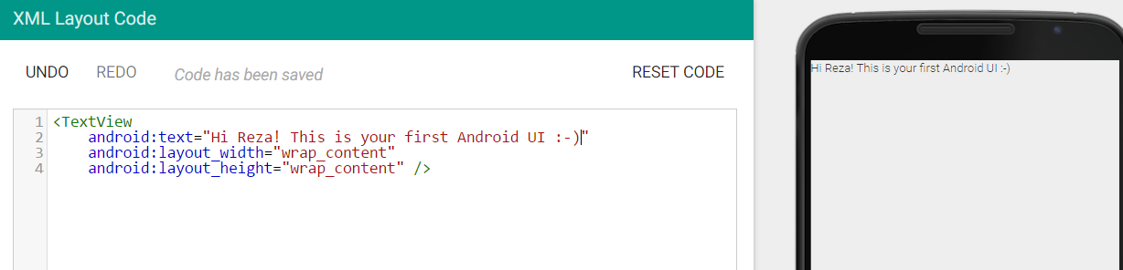
Views TextView Attributes
10
Try to change the value of android:text as shown below:

Slide 11
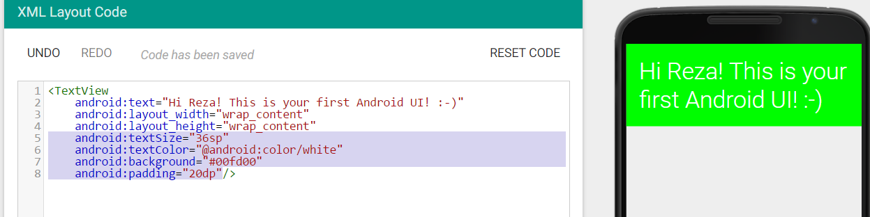
Views TextView Attributes
11
Add the following attributes to the TextView:

Slide 12
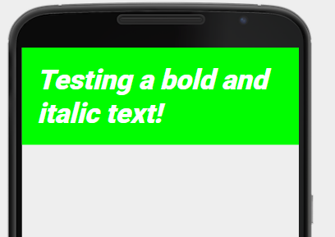
Views TextView Exercise
12
Use android documentation and find appropriate TextView attribute(s) to show the following text in bold and italic style.

Slide 13
Views TextView Density-Independent Pixels (DP)
13
The screen of an Android device is made of rows and columns of glowing dots called pixels.
Devices can range in screen density, which means how many pixels per inch (or dots per inch) are on the screen.
For example, an mdpi (or medium density device) has 160 dots per inch, while an xxhdpi (extra extra high density device) has 480 dots per inch.

Slide 14
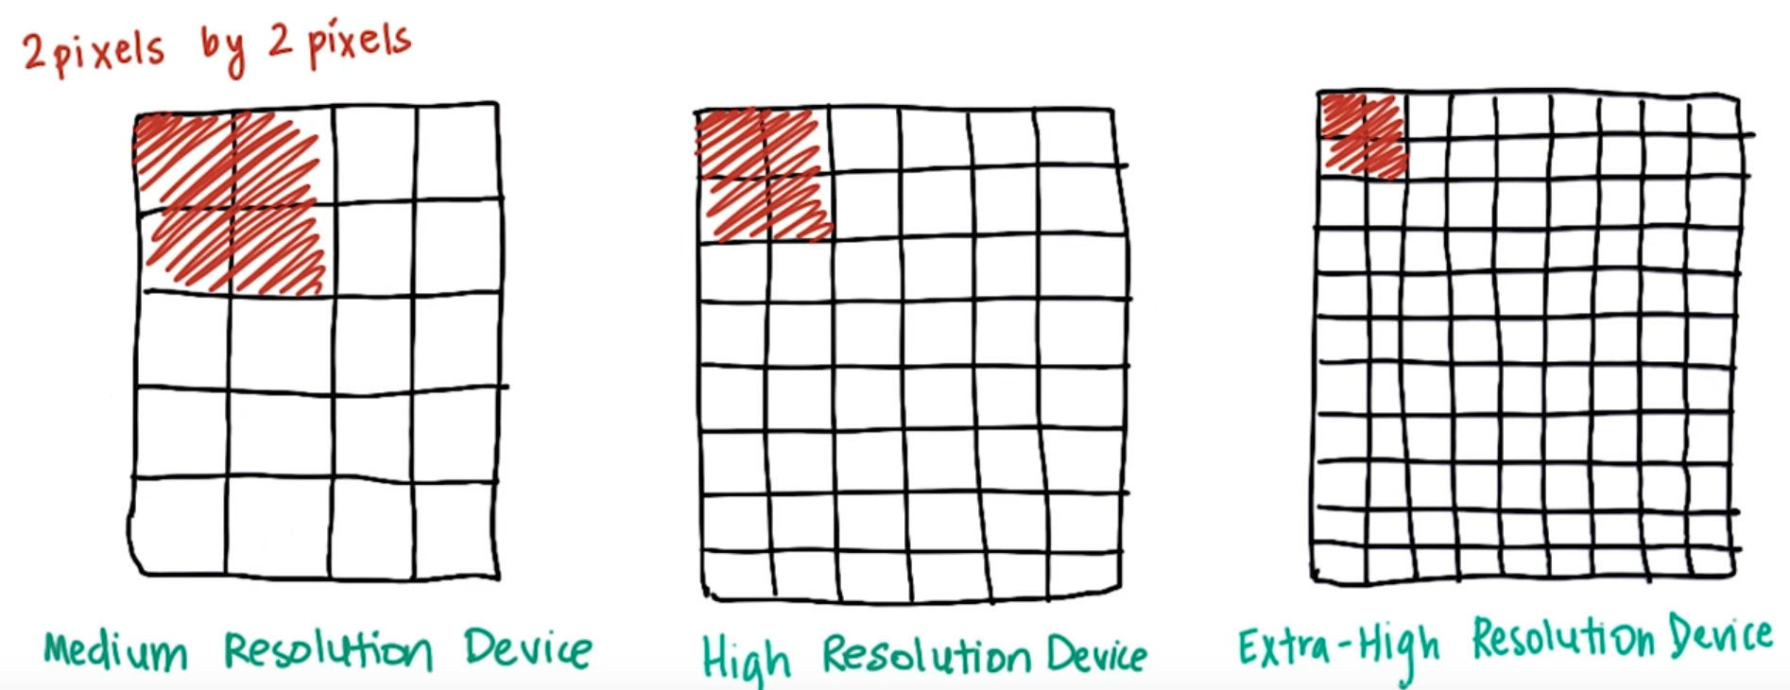
Views TextView Density-Independent Pixels (DP)
14
If we specify the size of views in pixel values, then views would appear very small on the higher density devices, where there are many pixels packed into a small area.
More information

Slide 15
Views TextView Density-Independent Pixels (DP)
15
To achieve a consistent physical size of Views, across devices of different screen densities, we use a unit of measure called a density-independent pixel (dp or dip).
1 dp is equal to 1 pixel on an mdpi device. 1 dp is equal to 3 pixels on an xxhdpi device, and so on for other devices.
That way, a button in an app on one device will be approximately the same physical size as that button in the same app running on a device with a different screen density.
Per Material design guidelines, any touch target on the screen should be at least 48 dp wide by 48 dp tall.

Slide 16
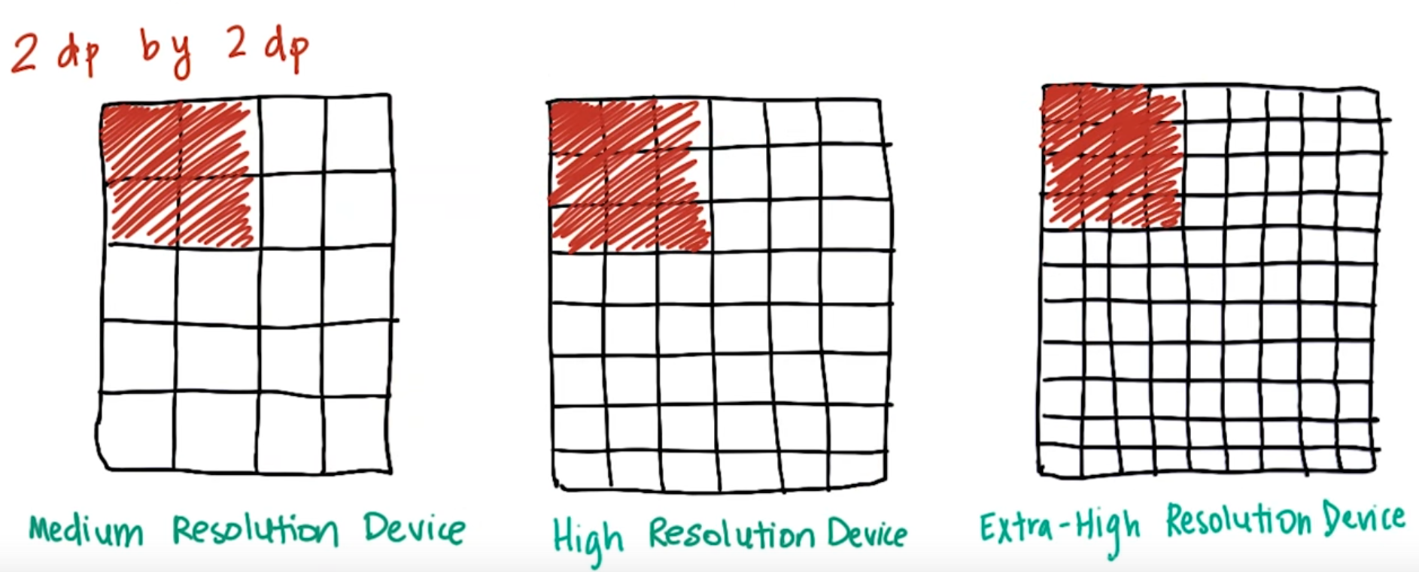
Views TextView Density-Independent Pixels (DP)
16
Android devices will automatically handle the conversion from dp to pixel values, so developers just have to use dp values when specifying measurements in their layouts.

Slide 17
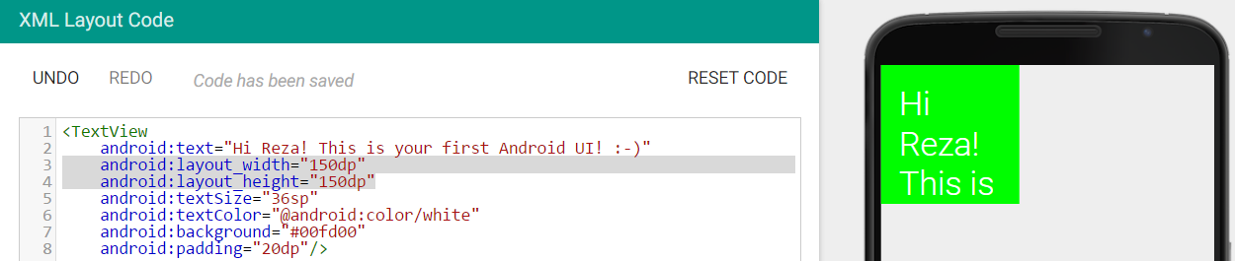
Views TextView Control Size Hard Coding
17
When you specify the width and height attributes of a control, the size of the control is fixed (i.e. hard coded).
If the content of the control requires more space, then android only shows the portion of content that can be fit in the given fixed size:

Slide 18
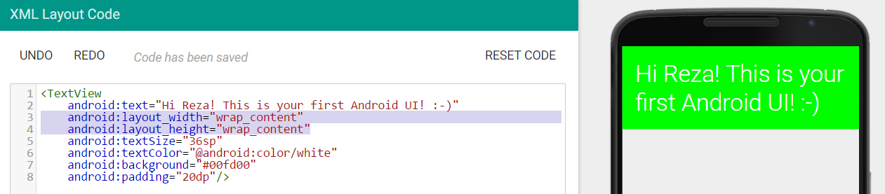
Views TextView Control Size Hard Coding
18
In order to avoid that, you can set size attributes with “wrap_content”.
This way the control size is automatically adjusted based on the content of the control.
More information

Slide 19
Views TextView Debugging
19
Identify four errors in this code:
<Text View
android:text="Hapy Birthday"
android:layout_width="150dp"
android:layout_height="150"
android:background="@android:color/darker_groy"
>

Slide 20
Views TextView Scale Independent Pixels
20
A scale-independent pixel (sp) is a unit of length for specifying the size of a font of type.
Its length depends on the user’s preference for font size, set in the Settings app of the Android device.
To respect the user’s preferences, you should specify all font sizes in scale-independent pixels.
All other measurements should be given in device-independent pixels (dp’s).

Slide 21
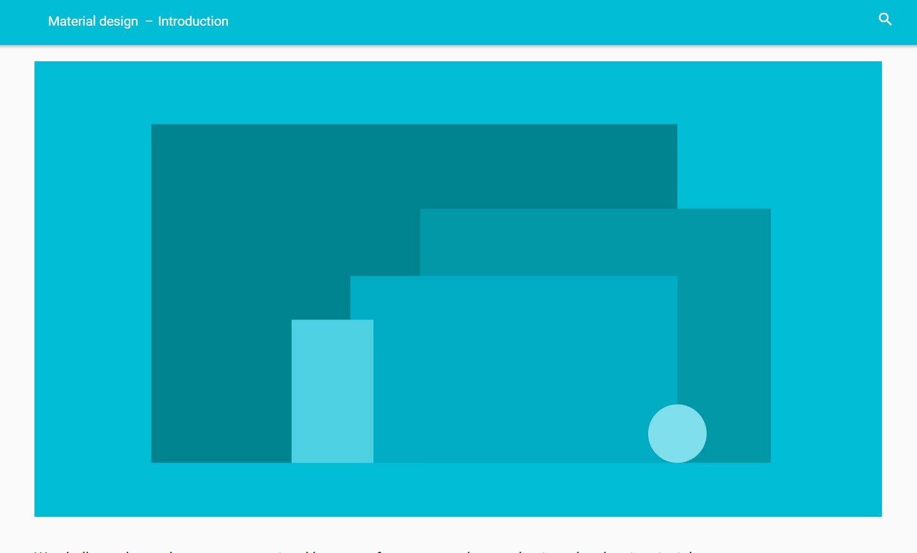
Material Design
21
Material Design is a design language developed by Google to help create consistent and beautiful apps across different devices and platforms.
The design specifications highlight the best practices for designing your app on the layout of your app, visual style, imagery, animations, etc.

Slide 22
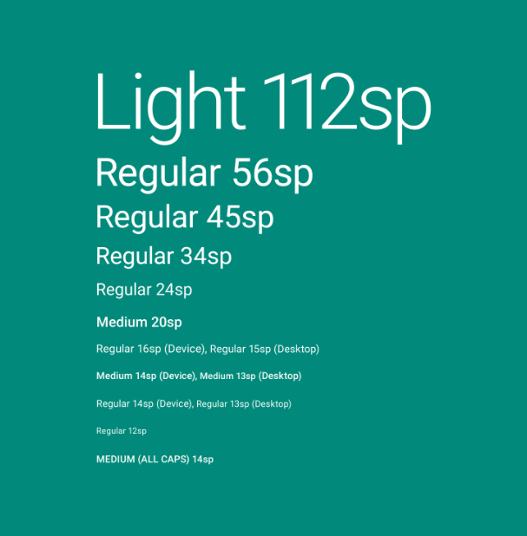
Material Design Typography
22
For example, these are the text sizes recommended by Material Design under typography section:

Slide 23
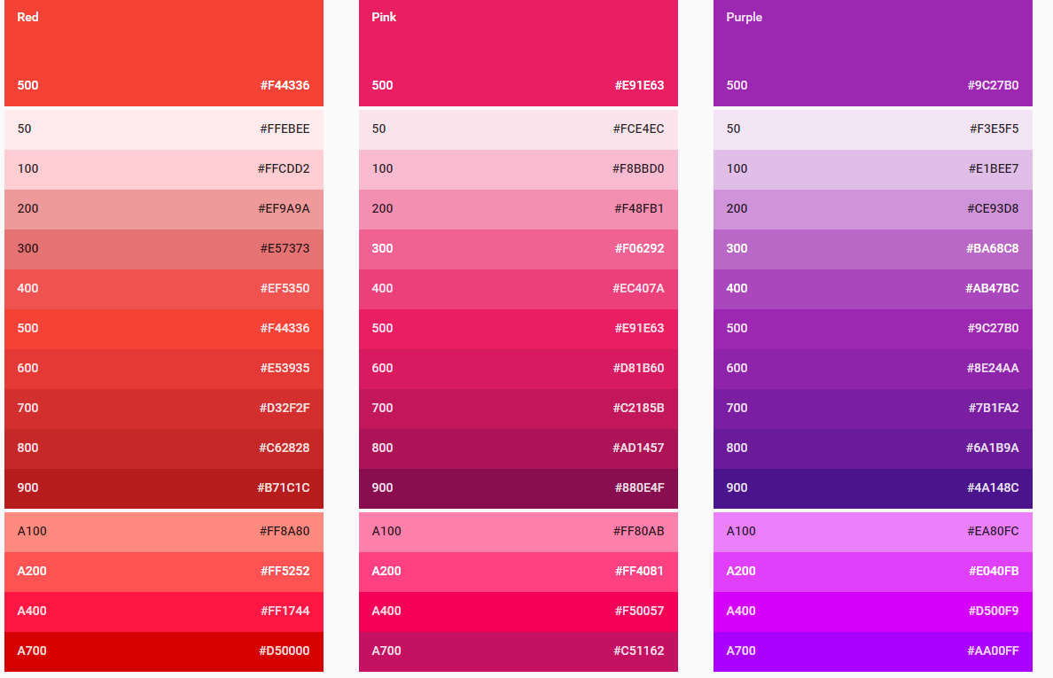
Material Design Color
23
Material Design also has recommendations for selecting colors by introducing Color Palette:
You can select the hex values (such as #9C27B0 and use it as values for color related attributes. For example:
android:textColor=" #9C27B0"

Slide 24
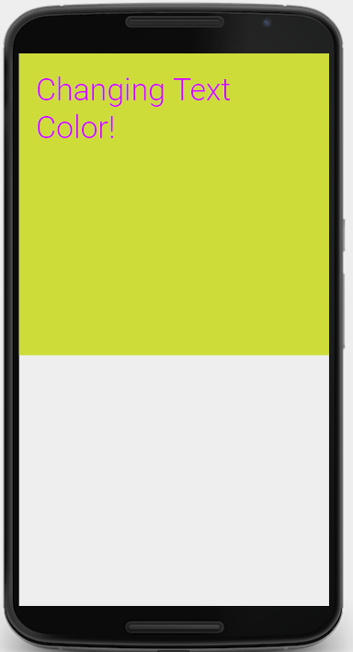
Exercise 1
24
Try to design the following UI.
Select proper colors from the Material Design Color Pallet

Slide 25
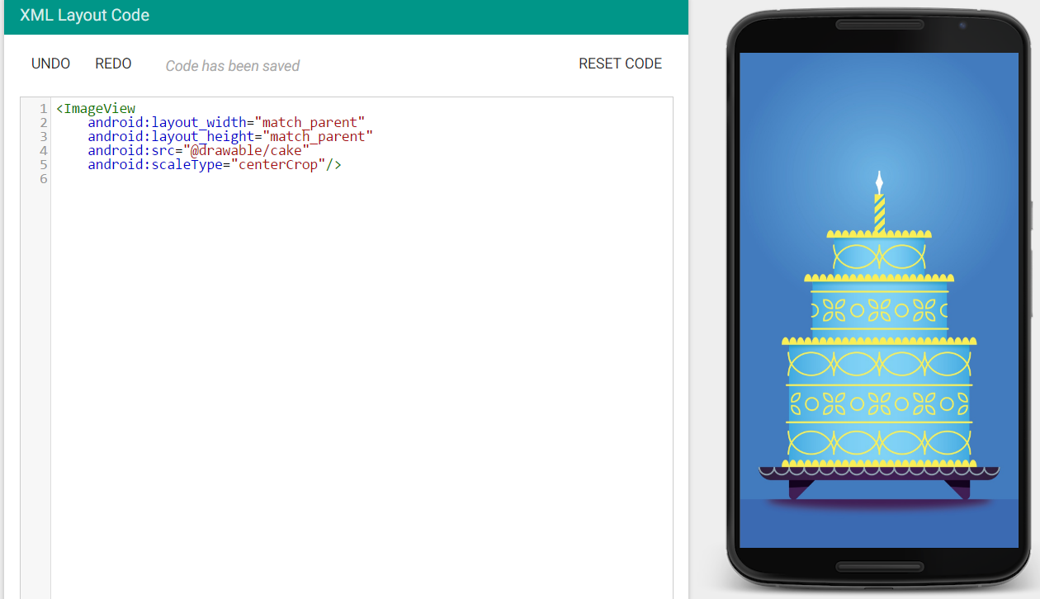
Views ImageView
25
ImageView is used to displays an image such as an icon or a photograph.

Slide 26
Views ImageView Attributes
26
android:src="@drawable/image_file_name" refers to the image file. There is no need to provide the image file extension like .jpg or .png. The images must be manually added to the drawable folder before it is being used. An error will be shown if the image does not exist.
android:scaleType=“value" controls how the image should be resized or moved to match the size of this ImageView when the image size or dimension does not match the view size. Possible values are:

Slide 27
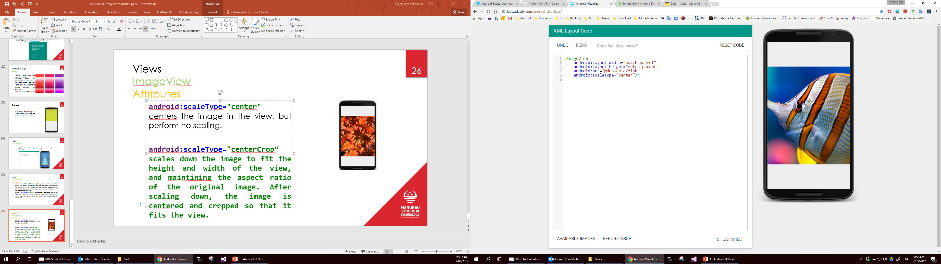
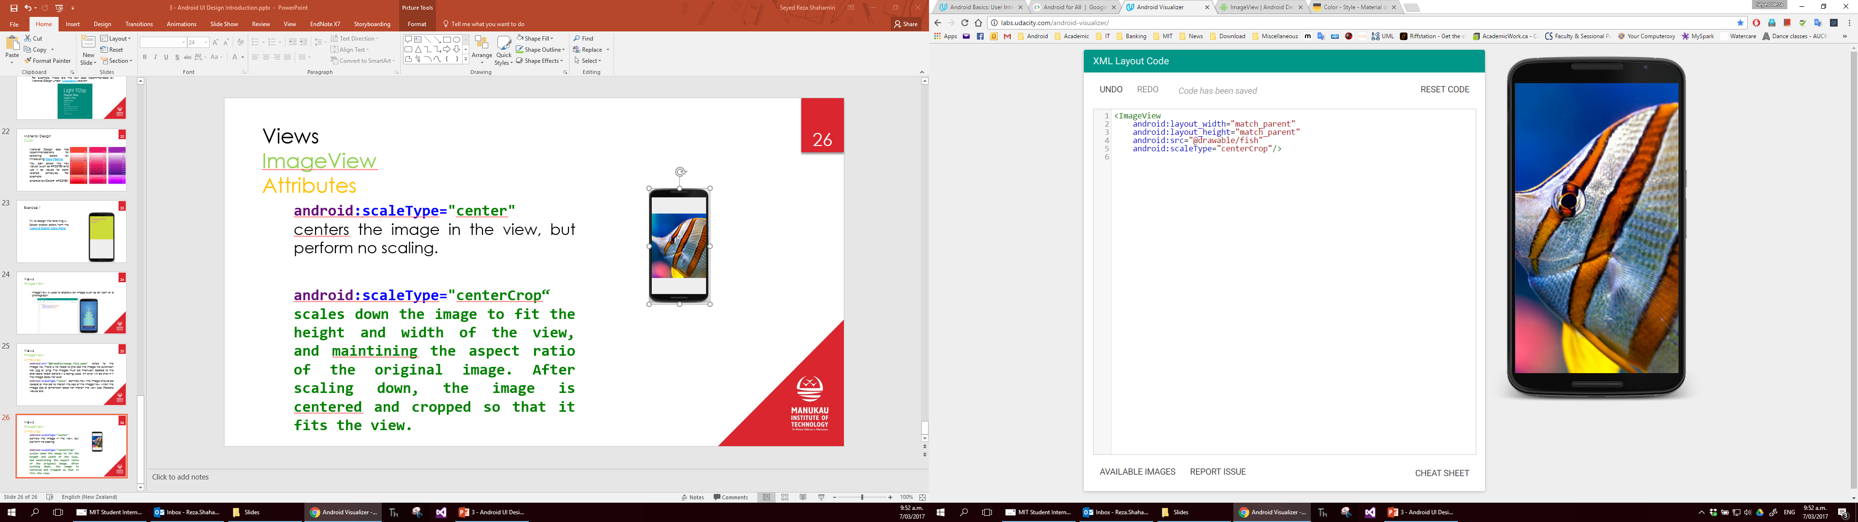
Views ImageView Attributes
27
android:scaleType="center" centers the image in the view, but perform no scaling.
android:scaleType="centerCrop“ scales down the image to fit the height and width of the view, and maintaining the aspect ratio of the original image. After scaling down, the image is cantered and cropped so that it fits the view.
Nost of the time we use centerCrop as it provides an edge-to-edge view of an image.

Slide 28
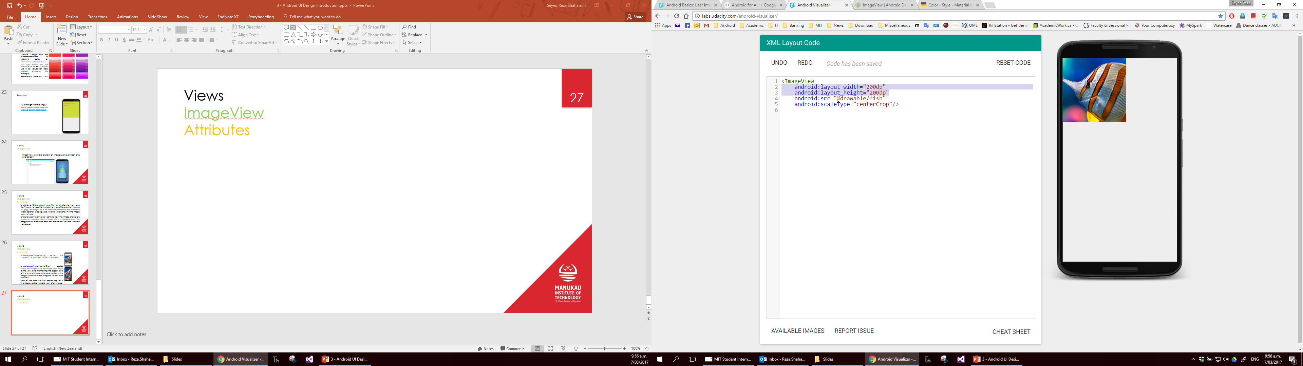
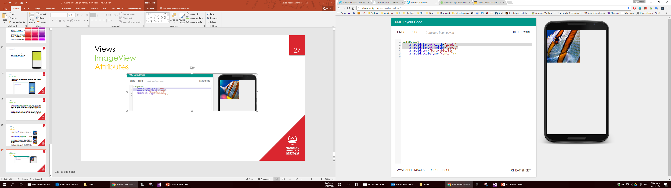
Views ImageView Attributes
28

